Slide 1


Slide 2
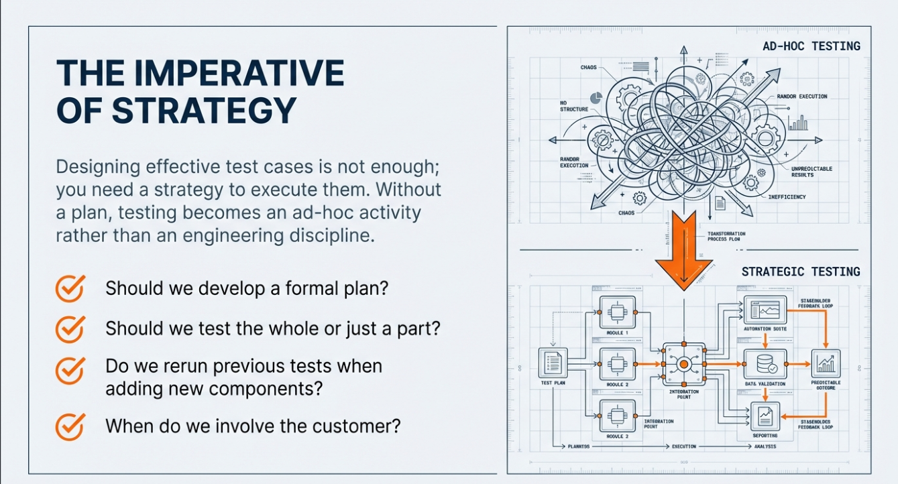

Slide 3
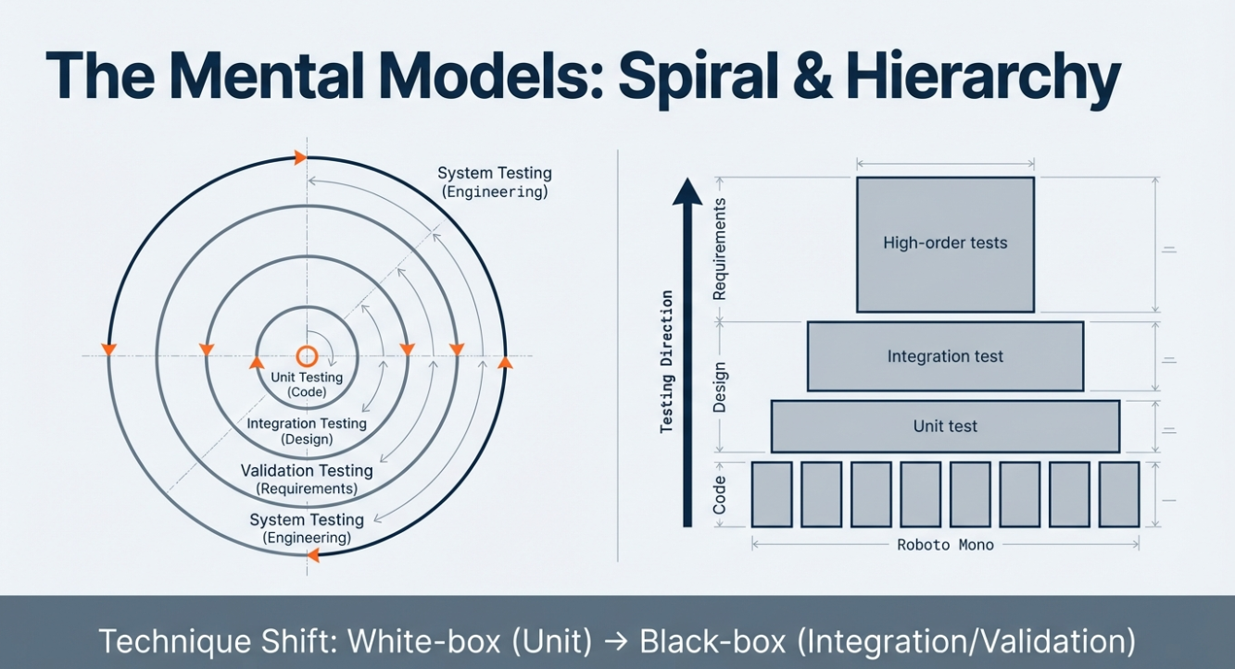

Slide 4


Slide 5


Slide 6


Slide 7
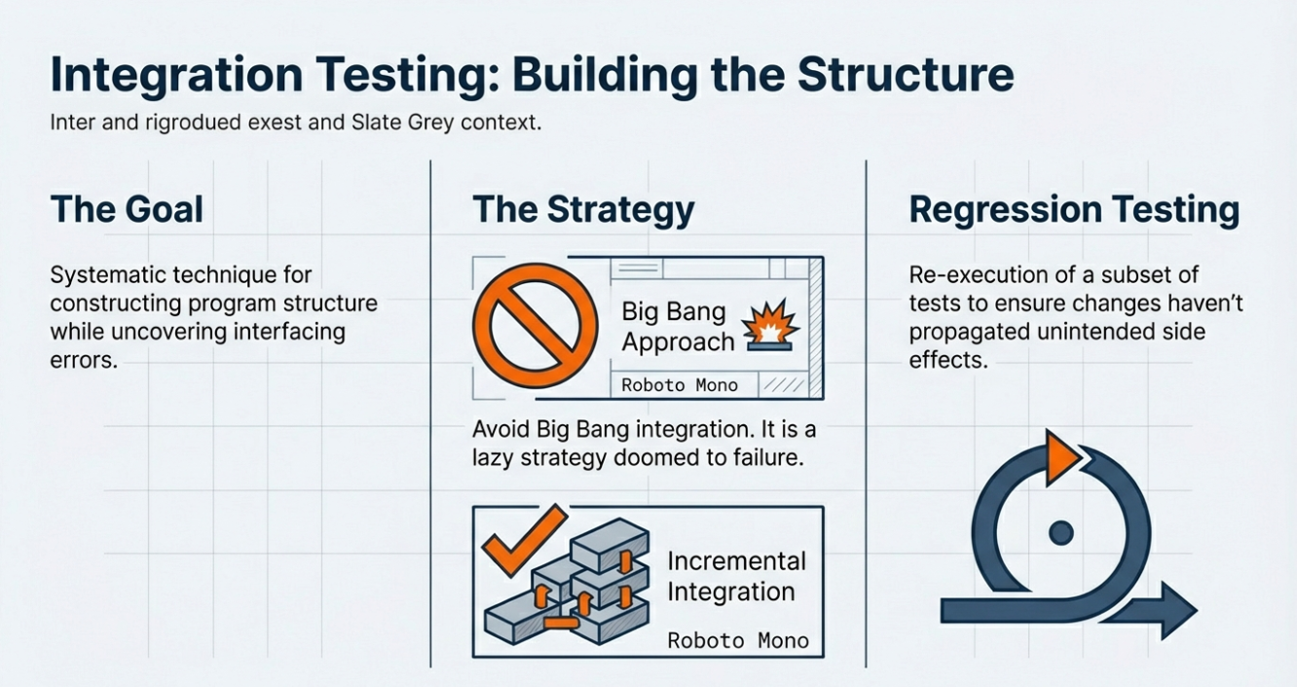

Slide 8
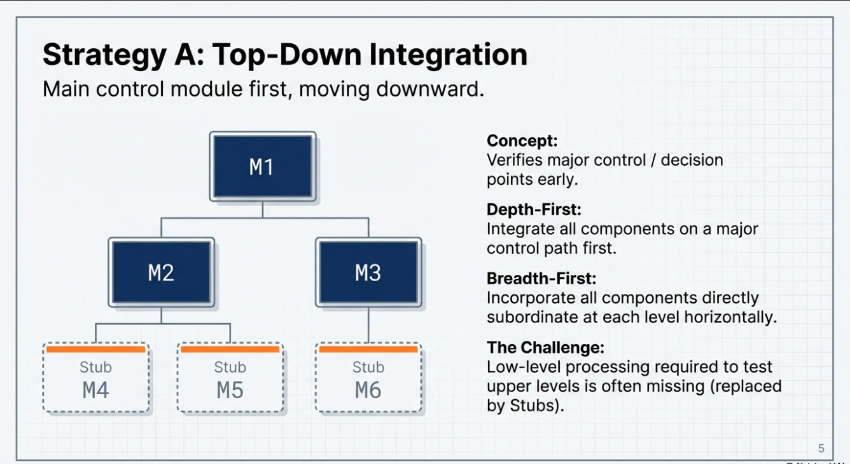

Slide 10


Slide 11
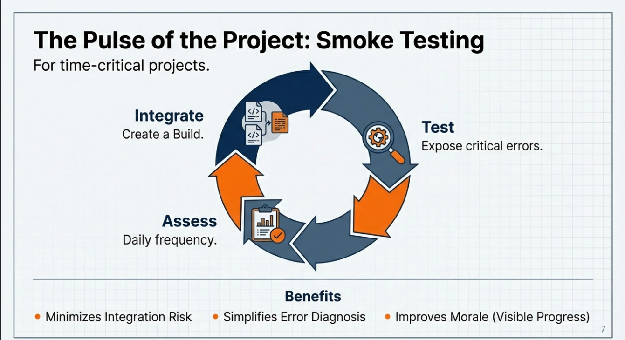

Slide 12
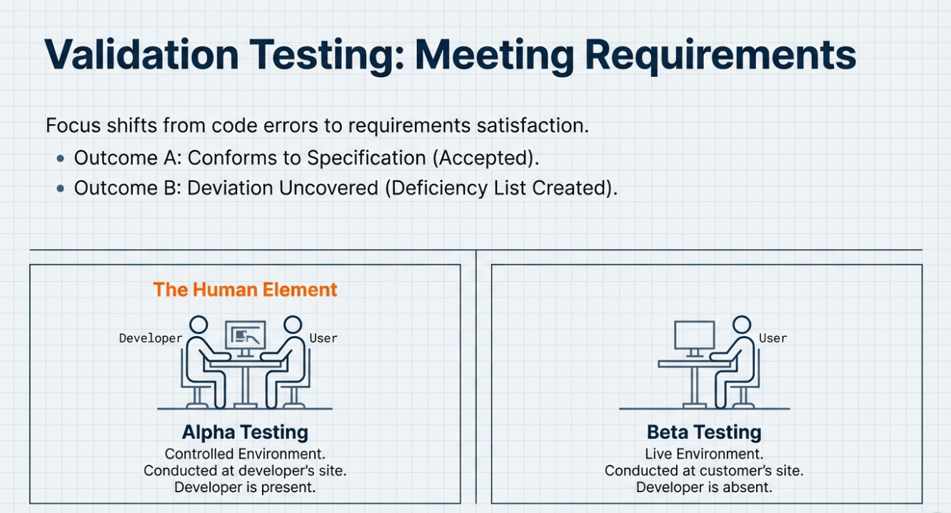

Slide 13
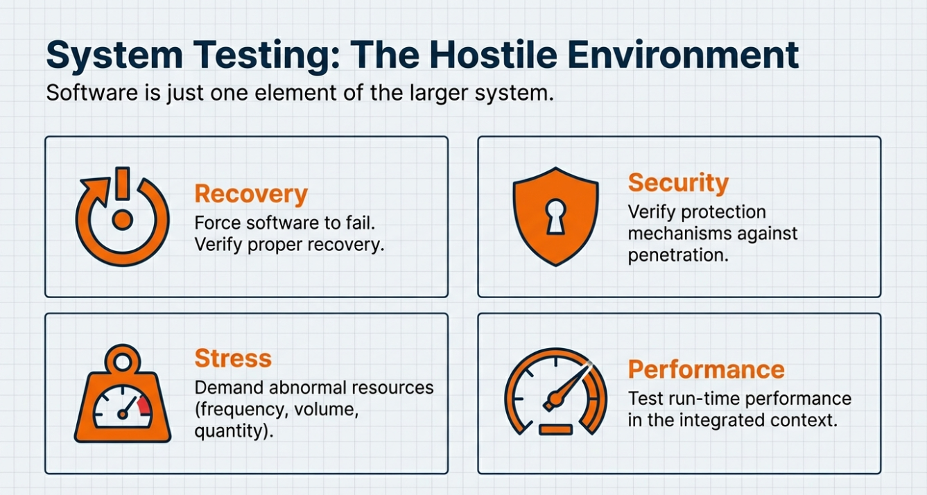

Slide 14

Error occurring at irregular intervals

Slide 15
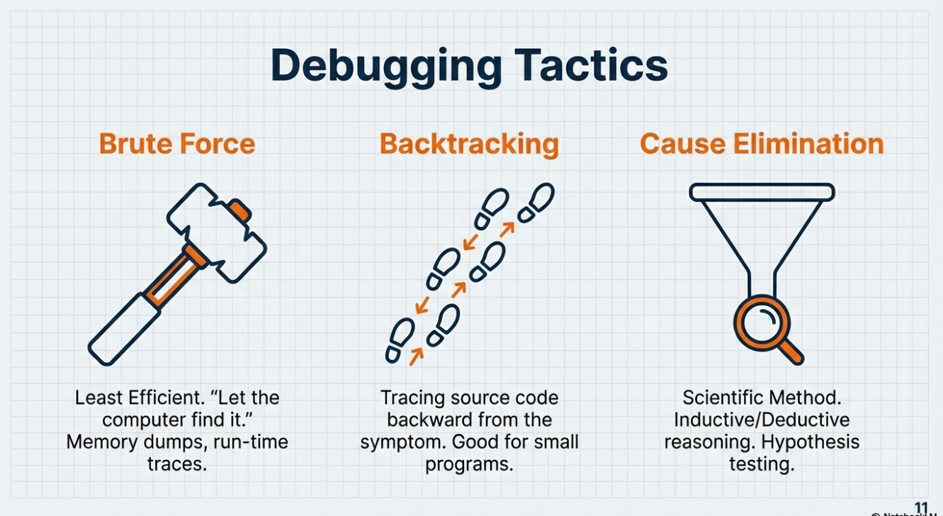
Inductive: Observe patterns, form hypotheses, develop theories Example: Seeing many swans are white, you infer all swans are white (until a black swan is seen).
deductiveStart with a theory, test hypotheses, confirm/reject Example: All dogs have fur (general). Pugs are dogs (specific). Therefore, pugs have fur (specific, certain)
(believing a cause is present when it isn't)
(missing a cause that is actually present).

Slide 16
End of Testing chapter

Slide 17

(uncertainty /randomness)

Slide 18
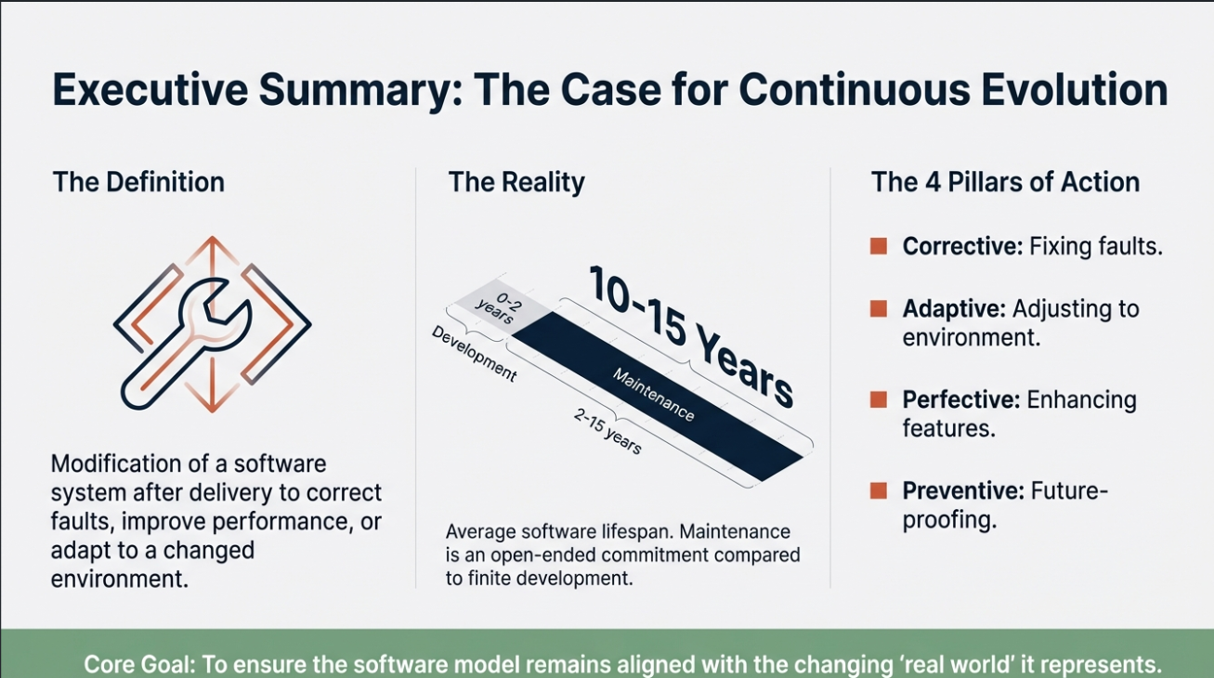

Slide 19
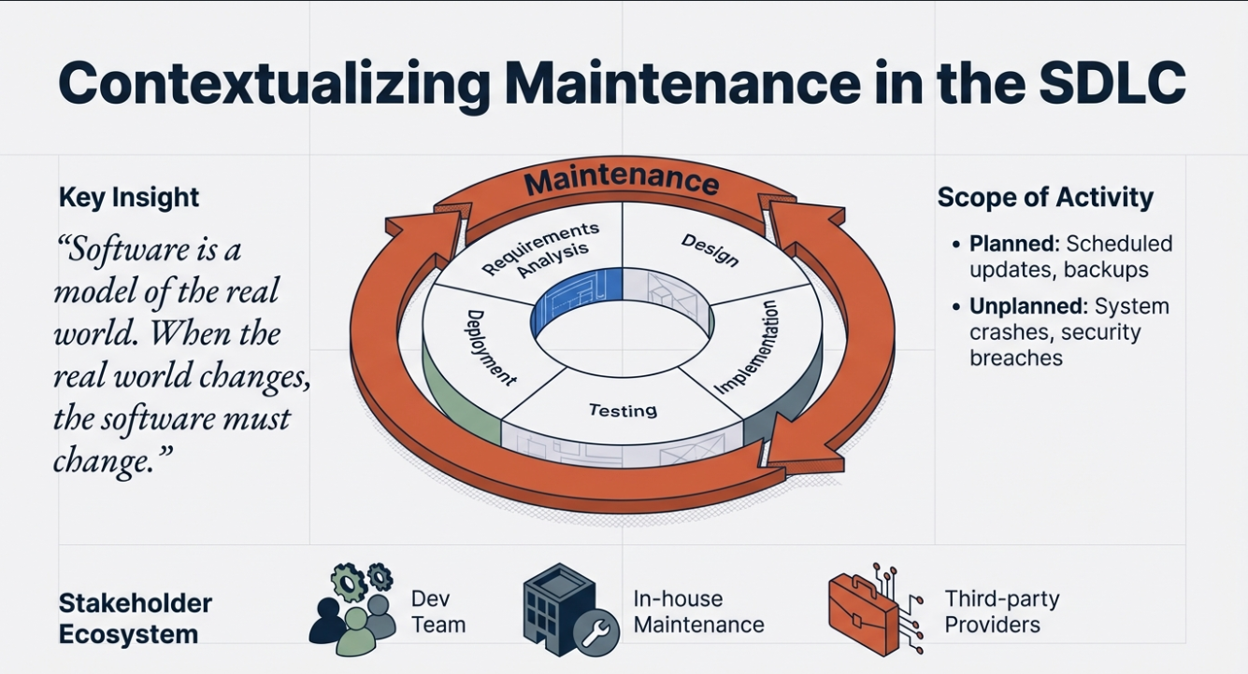

Slide 20


Slide 21
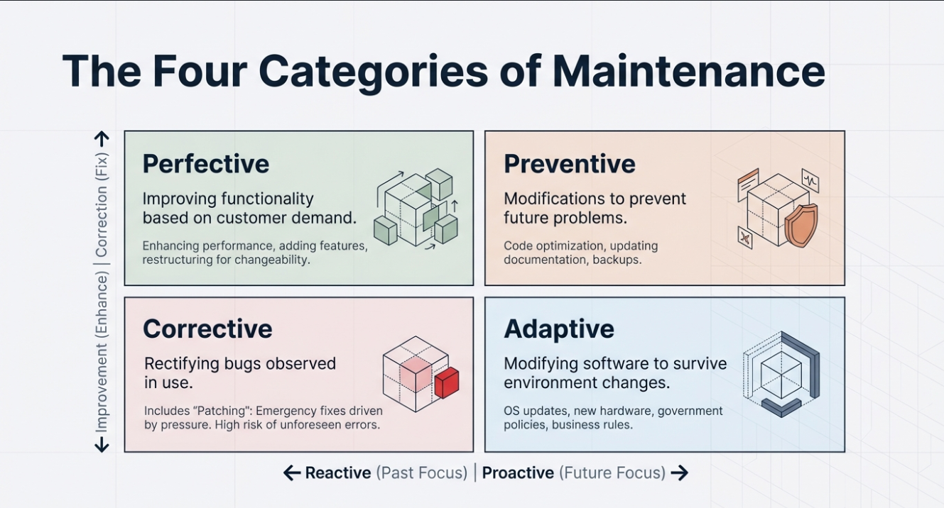

Slide 22
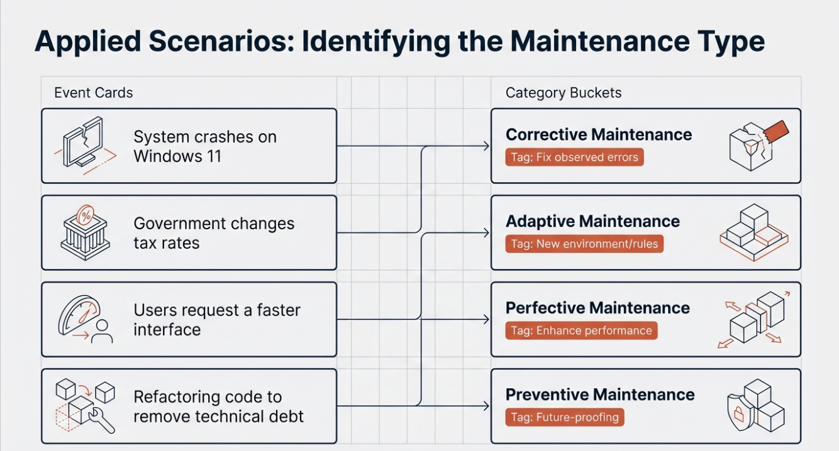

Slide 23
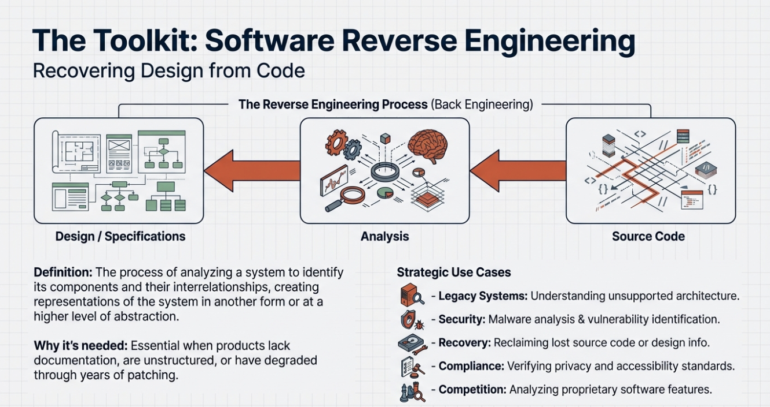

Slide 24
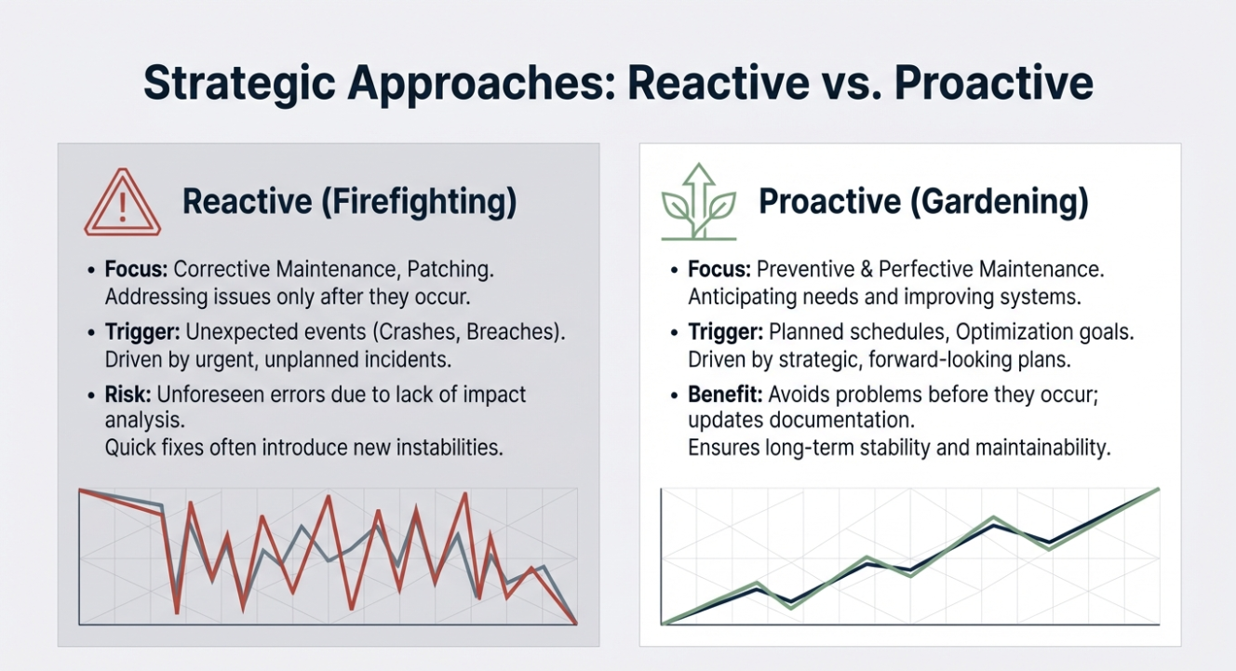

Slide 25


Slide 26


